Slide 1

QueuedUp
Abbas Engineer
James Goodman
Jay Ohana
Haolin Liu
Alex Davila
July 22, 2020
Notes:
Abbas

Slide 2
Introduction
Website for CSE students at UC Santa Cruz
Create and comment on discussions about classes, majors, or campus life
Users can create accounts, and edit their profile details and profile picture
We were motivated to choose this project because we wanted a community for CSE students
Notes:
Abbas

Slide 3
Goals
What we set out to achieve
Users can discuss and share topics relevant to CSE majors at UCSC
Posts can be liked/disliked with ++/-- buttons
Ability to post images
Ability to include code snippets and LaTeX-formatted snippets
What we actually achieved
Account sign up and log in
Editable profile details and profile pictures
Create and comment on posts
Like/dislike posts using our ++/-- system
No ability to post images, code snippets, nor LaTeX
No ability to search nor sort posts
Posts all load on one page; no separate pages

Slide 4
Challenges and Accomplishments
Challenges we faced
Learning new frameworks
Quotas for Firebase functions
Team communication
Scalability due to time constraint
Different time zones
Working within strict timebox
What we accomplished
Finished product mostly looks and functions like we envisioned
Utilized project management practices effectively
Accomplished tasks with effective communication despite working remotely
Teamwork makes the dream work bay-bee
Notes:
Alex

Slide 5
Timeline
Sprint 1
• Project set up
• Log in/sign up (BE)
• Add post (BE)
Sprint 3
• Editable user profiles
• Increment/decrement
posts
Team Creation
Release
Sprint 2
• Add post (FE)
• Edit/delete posts
• Comments
• Profile photo (BE)
Notes:
Jay

Slide 6
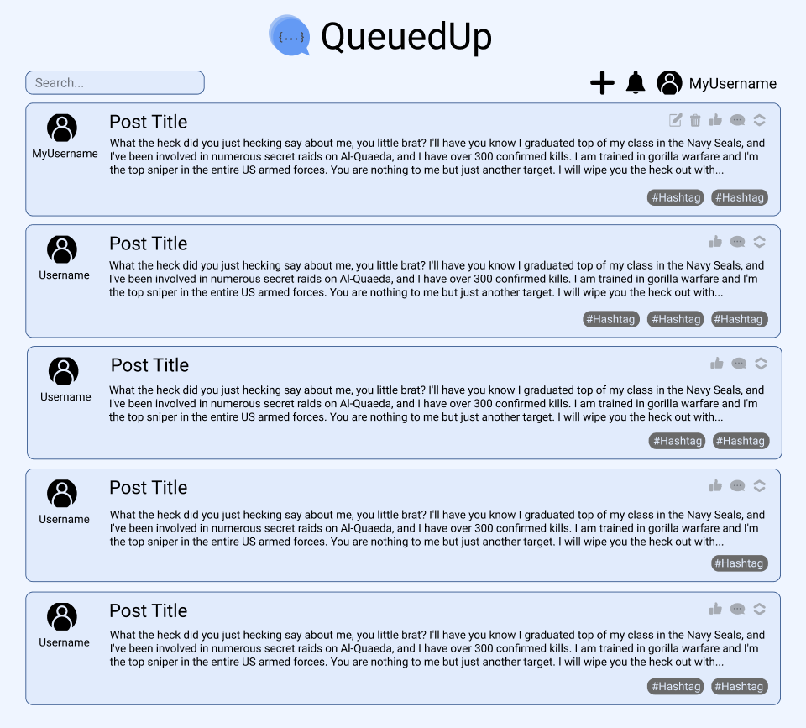
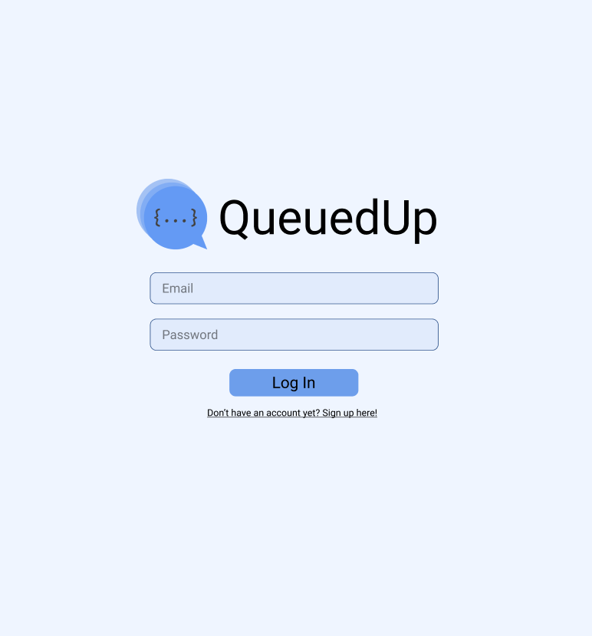
Design Mockup
Notes:
Jay

Slide 7
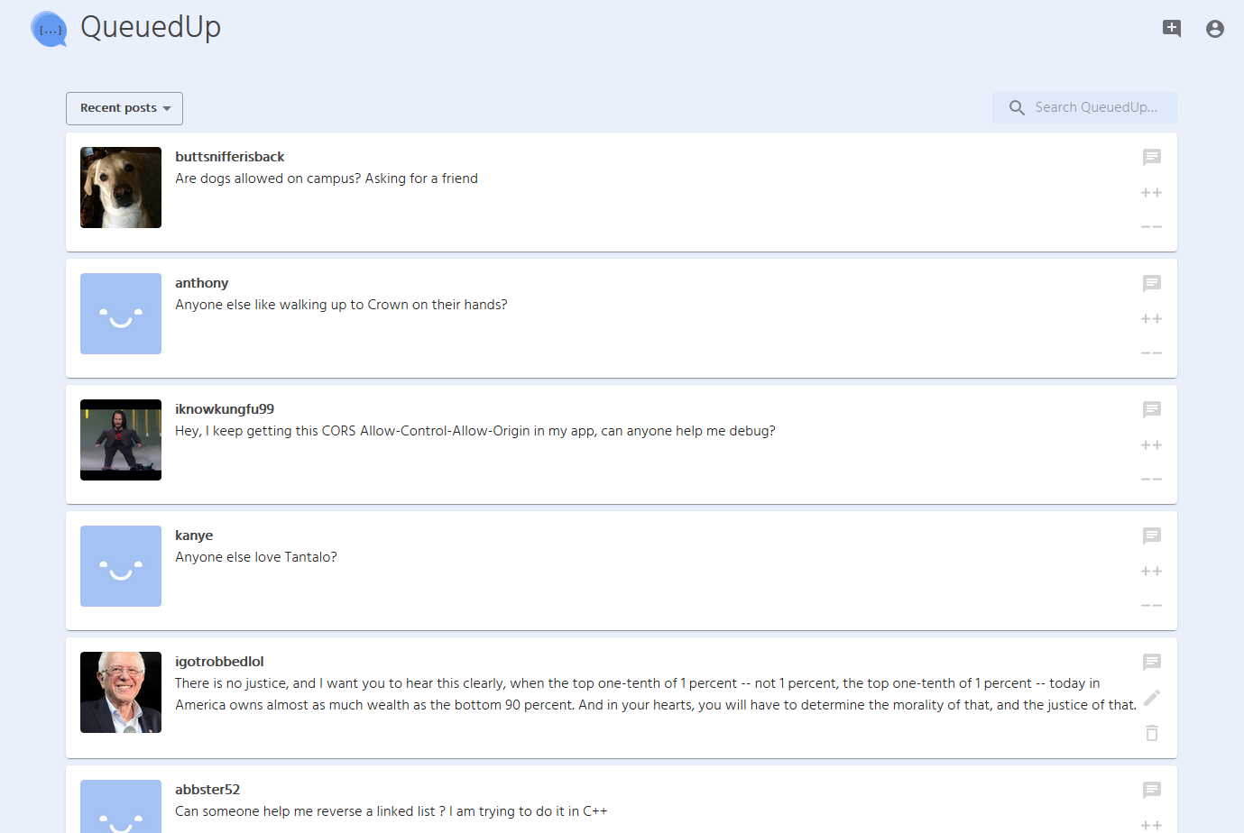
Finished Product:
Dashboard
Notes:
Jay

Slide 8
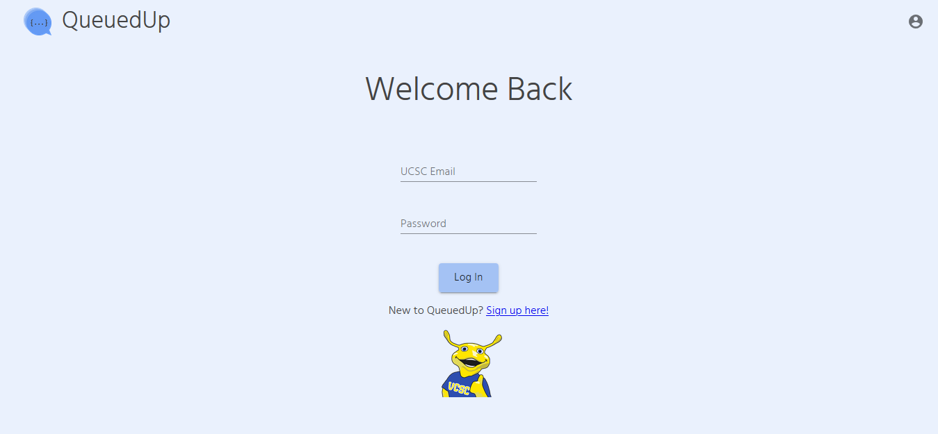
Finished Product:
Login
Notes:
Jay

Slide 9
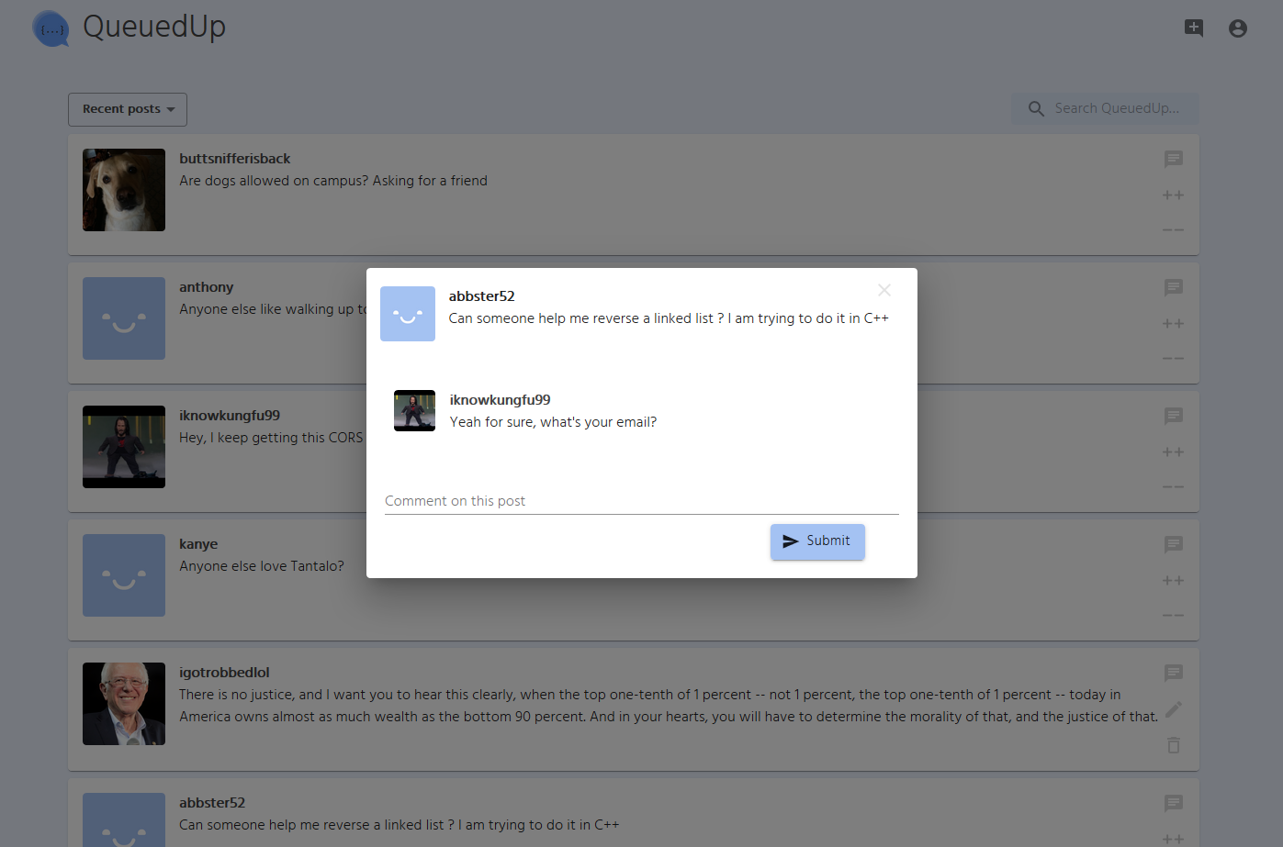
Finished Product:
Post Dialog/Comments
Notes:
Jay

Slide 10
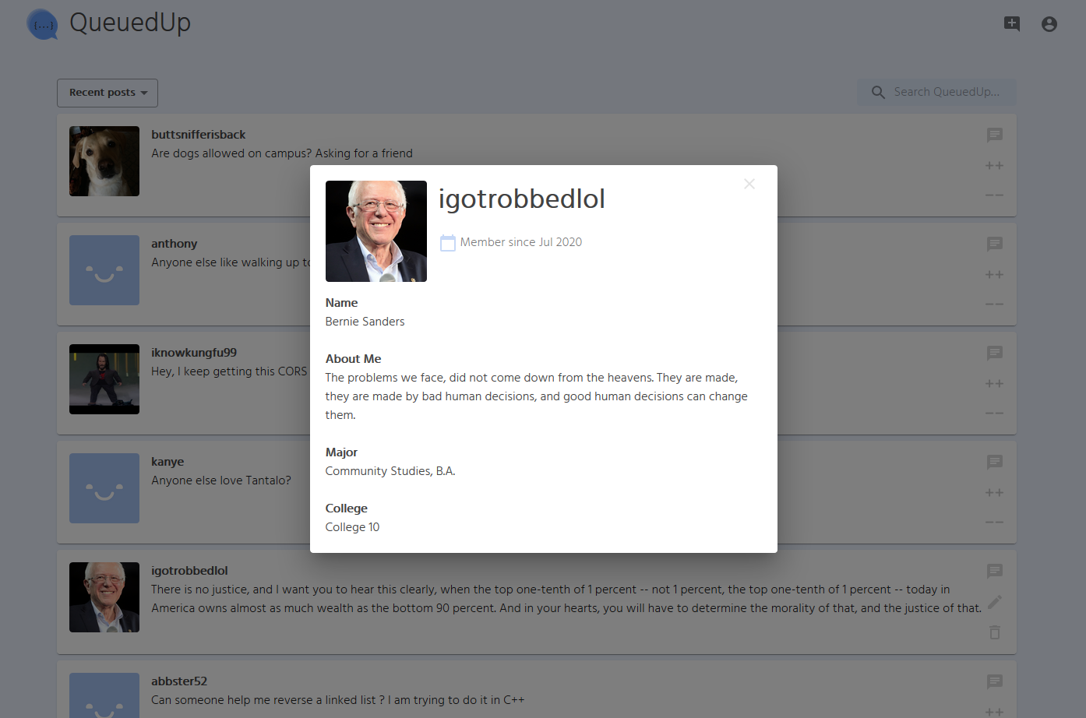
Finished Product:
Profile
Notes:
Jay

Slide 11

Walkthrough
Notes:
Abbas

Slide 12
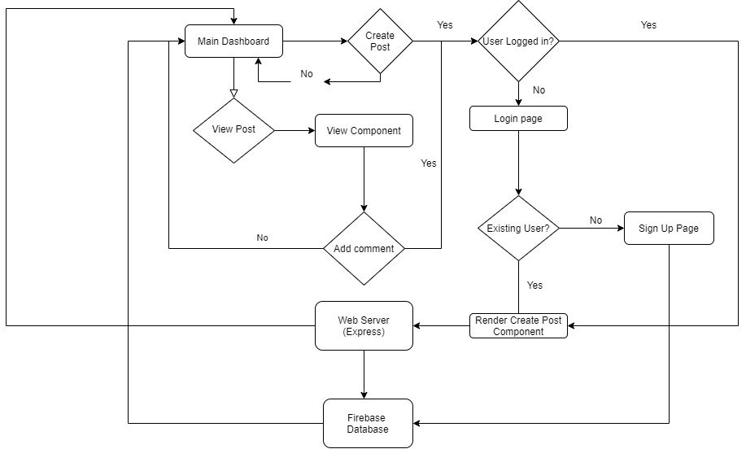
System Diagram
Notes:
Abbas

Slide 13
Technology
Server-side
Firebase: cloud storage, database, user authentication
Express: authentication middleware
Client-side
React: JavaScript library for building user interfaces
Redux: JavaScript library for managing application state.
Material-UI: React component library
Project Management
Slack: Team Communication
Trello: Project Management Tool
Postman: API access to data stored
Notes:
Abbas

Slide 14
Project Management Techniques
Scrum
Standup meetings
Burnup charts
Scrum board via Trello
Communication
Daily updates via Slack
Remote standups via Zoom
Best Practices
Planning Poker
Peer reviews
Pair programming
Notes:
Alex

Slide 15
What we liked
Teammates
Made something cool
Learned a ton
Notes:
Haolin

Slide 16
What we disliked
Firebase not optimal for our project scope
Wrestling with CSS
Can’t go out for celebration beers
Notes:
Haolin

Slide 17
Lessons Learned
Node.js and NPM make package management simple
Material UI is intuitive and looks clean.
Firebase is good for handling user authentication, but not worth it if you don’t plan on paying for it
Scrum helpful for keeping everyone on task and staying productive
Notes:
James

Slide 18
How COVID-19 Impacted Us
Time management more important
Adapting to circumstances
Online communication only
Notes:
James

Slide 19
Thanks!
Any questions?
Notes:
James

